Slide 1






Getting started with JavaScript
www.wscubetech.com

Slide 2
Our Agenda.
What is a variable ?
How to declare and initialize variables in js.
Scope and Lifetime of a variable
How To Declare variable in JavaScript
Important Functions of JavaScript. Practical Implementation
www.wscubetech.com

Slide 3
Variables in JavaScript.
Variables are containers which hold reusable data.
It is the basic unit of storage in a program.
The value stored in a variable can be changed during program execution.
1
2
3
www.wscubetech.com

Slide 4
How to declare & initialize variable in JavaScript.
//declaring single variable
var name;
// declaring multiple variables
var name, title, num;
//declaring single variable
var name;
// declaring multiple variables
var name, title, num;
// initializing variables
var name = "Harsh";
name = "Rakesh";
www.wscubetech.com

Slide 5
Scope and life time of a variable.
Scope of a variable
Variables declared within a function are local to that function.
Variables declared outside of any function are global variables
Scope of a variable
Local variable’s life time is within the block of its declaration.
Global variable’s life time is throughout the program.
Life time of a variable
www.wscubetech.com

Slide 6
How To Declare variable in JavaScript
var
const
let
www.wscubetech.com

Slide 7
Important Functions of JavaScript. Practical Implementation
1. alert()
2. confirm()
3. console.log()
4. document.write()
5. prompt()
www.wscubetech.com

Slide 8
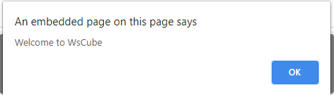
What is alert() and how to use?
alert(): It is used to alert the user that something has happened.
alert() : It is used to alert the user that something has happened.
<script type=“text/javascript”>
alert(“Welcome To WsCube”);
</script>
www.wscubetech.com

Slide 9
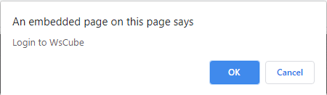
What is confirm() and how to use ?
alert(): It is used to alert the user that something has happened.
confirm():Opens up a Confirm/Cancel dialog and returns true/false depending on user’s click
<script type=“text/javascript”>
confirm(“Login to WsCube”);
</script>
www.wscubetech.com

Slide 10

What is console.log() and how to use ?
alert(): It is used to alert the user that something has happened.
console.log(): Writes information to the browser console, good for debugging purposes
<script type=“text/javascript”>
console.log("WsCube JavaScript Tutorials");
</script>
www.wscubetech.com

Slide 11
What is document.write() and how to use ?
alert(): It is used to alert the user that something has happened.
document.write(): Write directly to the HTML document
WsCube Tech
<script type=“text/javascript”>
document.write("WsCube Tech");
</script>
www.wscubetech.com

Slide 12
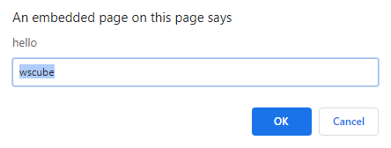
What is prompt() and how to use ?
alert(): It is used to alert the user that something has happened.
prompt(msg, default): Creates an dialogue for user input
<script type=“text/javascript”>
prompt(“hello",“wscube");
</script>
www.wscubetech.com

Slide 13



@wscube
@wscubetech.india
www.wscubetech.com
Subscribe To Get Notified about New Videos

